Slide 1
Generative Adversarial Networks
Alex Dimakis @AlexGDimakis
Nikolaos Vasiloglou @vasiloglou

Slide 2
Some pointers:
Our twitter accounts: @AlexGDimakis @vasiloglou
Alex homepage for research: http://users.ece.utexas.edu/~dimakis/
More on Backprop:
https://page.mi.fu-berlin.de/rojas/neural/chapter/K7.pdf
https://medium.com/@karpathy/yes-you-should-understand-backprop-e2f06eab496b
Theoretical results on Learning theory and expressiveness of neural nets: ‘Understanding Machine Learning’ Book by Shai Shalev-Shwartz et al.
http://www.cs.huji.ac.il/~shais/UnderstandingMachineLearning/understanding-machine-learning-theory-algorithms.pdf
https://github.com/AshishBora/csgm DCGAN and compressed sensing paper implementation

Slide 3
Outline
Recap: CNNs
Generators (GANs and VAEs)
How to train generating models (traditional ML)
Adversarial Training
Experiments in notebook
Extensions and current research

Slide 4
Convolutional Neural Net Architectures
x(1)
w₁
Reuse weights
Avoid full connectivity
Reduce the number of parameters you have to train
Provide translational invariance.
Makes sense for images
h₀(1)
w₂
x(2)
y
w₁
h₀(2)
w₂
x(3)
w₁
h₀(3)
w₂
x(4)

Slide 5
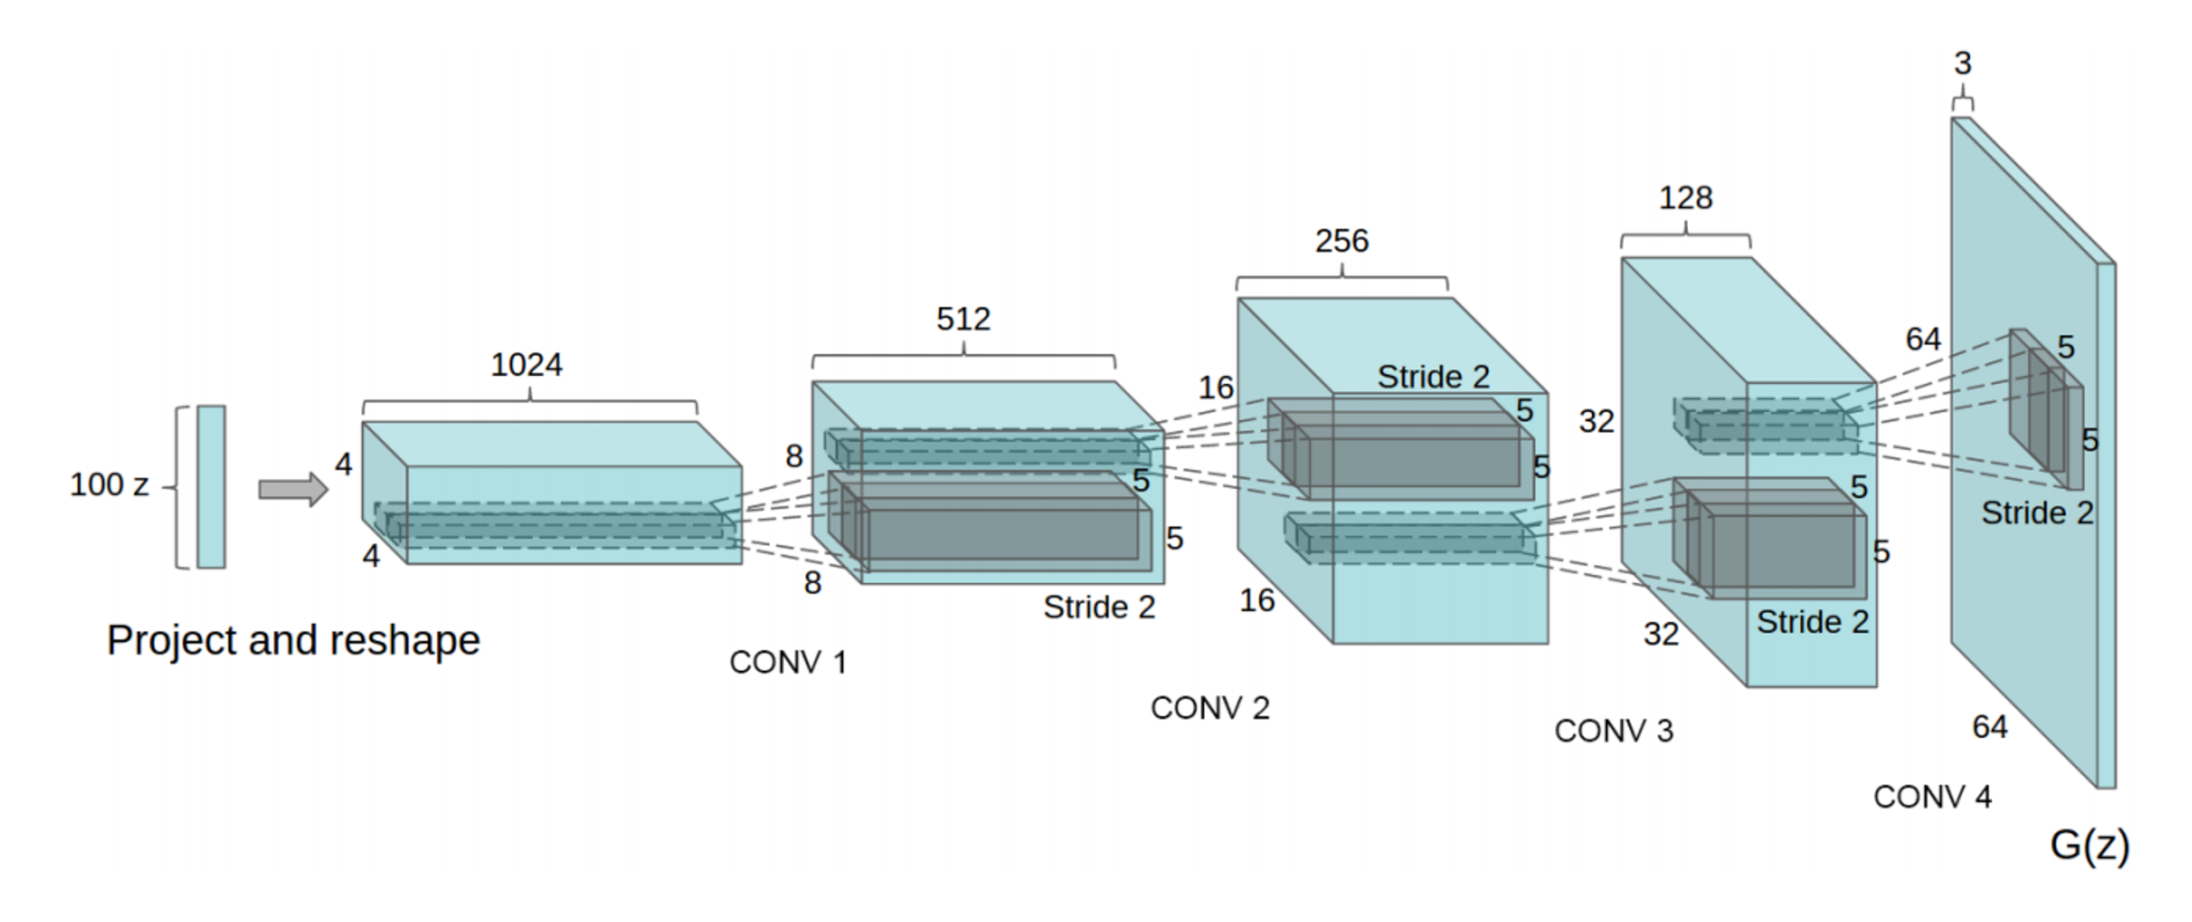
DCGan Architecture
based on https://github.com/carpedm20/DCGAN-tensorflow

Slide 6
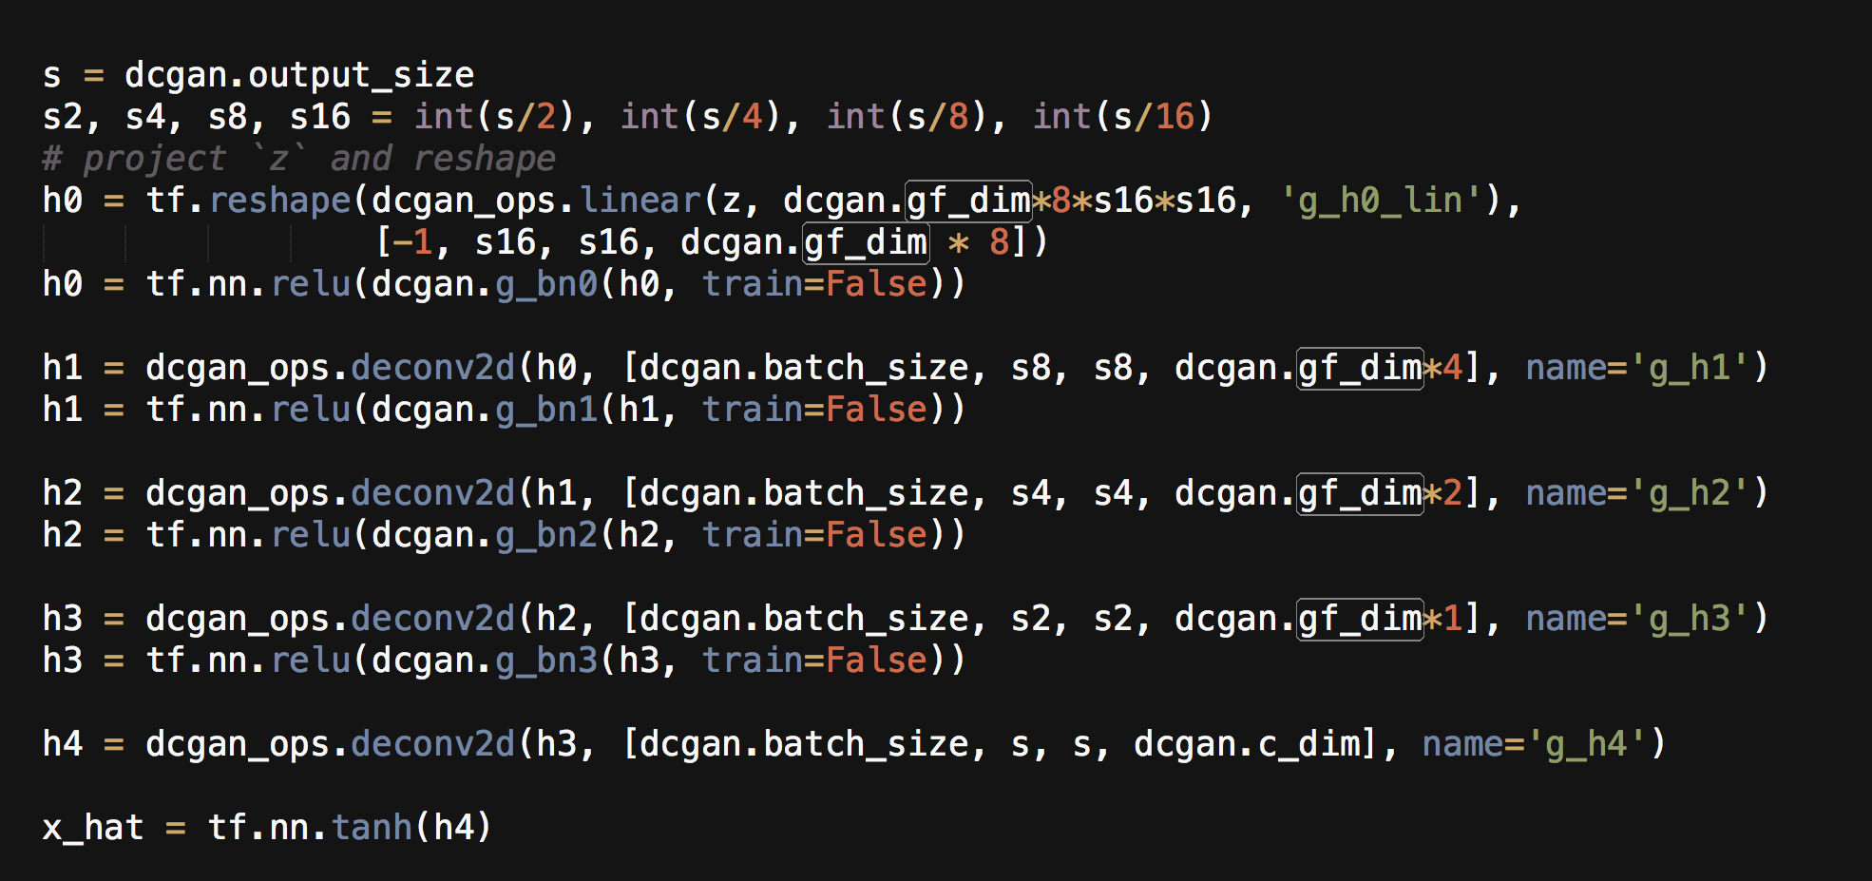
DCGan Architecture
based on https://github.com/carpedm20/DCGAN-tensorflow

Slide 7
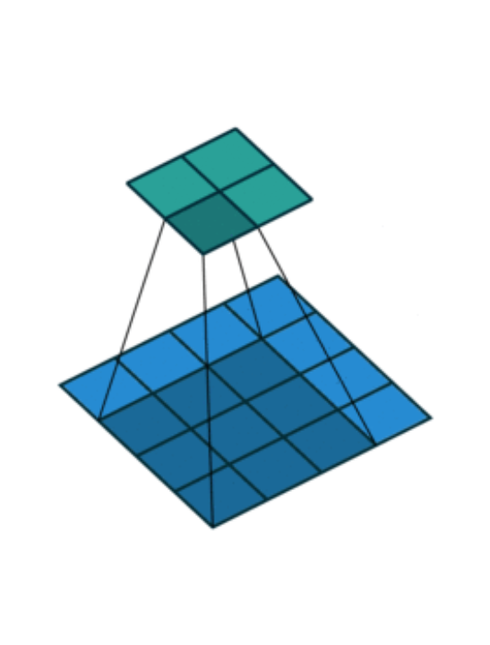
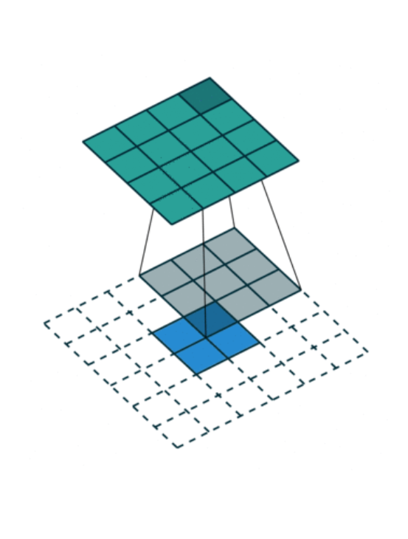
How deconvolution Layers work
Convolution Layer
DeConvolution Layer
(aka Transposed Convolution)
From: https://github.com/vdumoulin/conv_arithmetic
see for more fun animations

Slide 8
Generators
(GANS and VAEs)

Slide 9
Adversarial Training
``There are many interesting recent development in deep learning, probably too many for me to describe them all here.
The most important one, in my opinion, is adversarial training (also called GAN for Generative Adversarial Networks).
This, and the variations that are now being proposed is the most interesting idea in the last 10 years in ML, in my opinion.’’
-Yann LeCunn

Slide 10
Generative Adversarial Networks
We want to learn a probability distribution over images
Be able to sample ‘a random face image’
This is an unsupervised problem: no labels, just data
Standard way: maximize the likelihood of the data over all generative models.
Alternative way: Adversarial training.

Slide 11
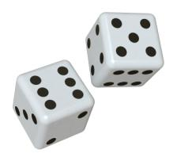
Let’s understand standard training
z(1)= Uniform [1,2,3,4,5,6].
z(2)= Uniform [1,2,3,4,5,6] (independent)

Slide 12
Let’s understand standard training
z(1)= Uniform [1,2,3,4,5,6].
z(2)= Uniform [1,2,3,4,5,6] (independent)
g(z) = w1* z(1) + w2*z(2)
z(1)
w1
g(z)
z(2)
w2

Slide 13
Let’s understand standard training
Say Data is D=[12 ]
What is the chance to see D
under weights
w(1)=1, w(2)=1 ?
z(1)= Uniform [1,2,3,4,5,6].
z(2)= Uniform [1,2,3,4,5,6] (independent)
g(z) = w1* z(1) + w2*z(2)
z(1)
w1
g(z)
z(2)
w2

Slide 14
Let’s understand standard training
Say Data is D=[12 ]
What is the chance to see D
under weights
w(1)=1, w(2)=1 ?
Pr(D |[1,1]) = 1/36
What if Data D=[12,15]
z(1)= Uniform [1,2,3,4,5,6].
z(2)= Uniform [1,2,3,4,5,6] (independent)
g(z) = w1* z(1) + w2*z(2)
z(1)
w1
g(z)
z(2)
w2

Slide 15
Let’s understand standard training
Say Data is D=[12 ]
What is the chance to see D
under weights
w(1)=1, w(2)=1 ?
Pr(D |[1,1]) = 1/36
What if Data D=[12,15]
Pr(D | w=[1,1]) = 1/36 * 0
If w1=2, w2=1
Pr (12 |w=[2,1]) =?
z(1)= Uniform [1,2,3,4,5,6].
z(2)= Uniform [1,2,3,4,5,6] (independent)
g(z) = w1* z(1) + w2*z(2)
z(1)
w1
g(z)
z(2)
w2

Slide 16
Let’s understand standard training
For any given w, we can compute Pr[ Data | weights w] = function(w)
max_w Pr[ D| w]
Find the weights that maximize the likelihood of the data
Say Data is D=[12 ]
What is the chance to see D
under weights
w(1)=1, w(2)=1 ?
Pr(D |[1,1]) = 1/36
What if Data D=[12,15]
Pr(D | w=[1,1]) = 1/36 * 0
If w1=2, w2=1
Pr (12 |w=[2,1]) =?
z(1)= Uniform [1,2,3,4,5,6].
z(2)= Uniform [1,2,3,4,5,6] (independent)
g(z) = w1* z(1) + w2*z(2)
z(1)
w1
g(z)
z(2)
w2

Slide 17
Let’s understand standard training
z(1)
w1
g(z)
z(2)
w2
Standard unsupervised training: maximize the likelihood of the data.
Choose the parameters w that max Pr[ D | w ]
(Non-convex tricky problem to solve)

Slide 18
Adversarial Training
Start from a simple distribution z ~ Uniform in R¹⁰⁰
Transform z through a MLP to get G(z) an artificial image
Create second network D(x) that takes image input and produces a scalar:
D(x) is trying to become: the probability that the image came from the data rather than G.

Slide 19
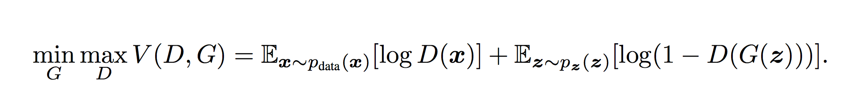
Adversarial Training
Train D to maximize the probability of the correct label.
Train D on both real images and samples from G
Train G to min log ( 1- D( G(z))
or max log D(G(z) )

Slide 20
Adversarial Training
Train D to maximize the probability of the correct label.
Train D on both real images and samples from G
Train G to min log ( 1- D( G(z))
or max log D(G(z) )
G(z)
z
D(x)
Real Images

Slide 21
Adversarial Training
This is now a machine that can dream up new faces: put in a random z
And run G(z).
G(z)
z

Slide 22
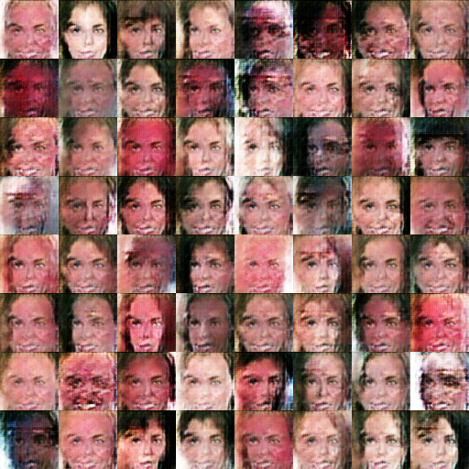
Adversarial Training

Slide 23
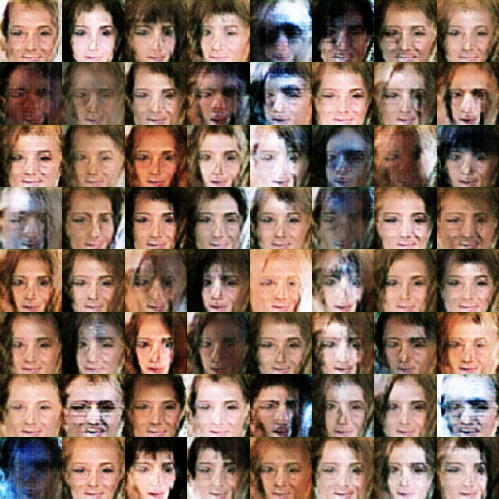
Adversarial Training

Slide 24
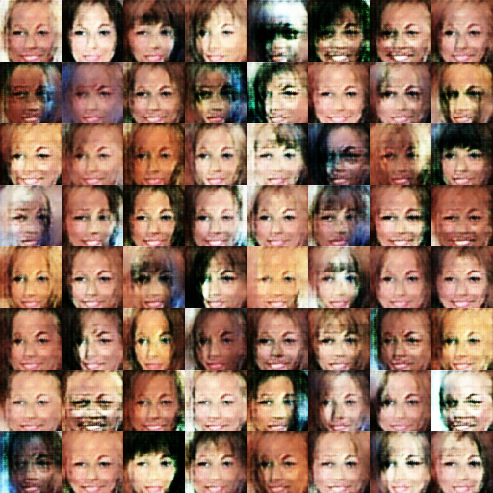
Adversarial Training

Slide 25
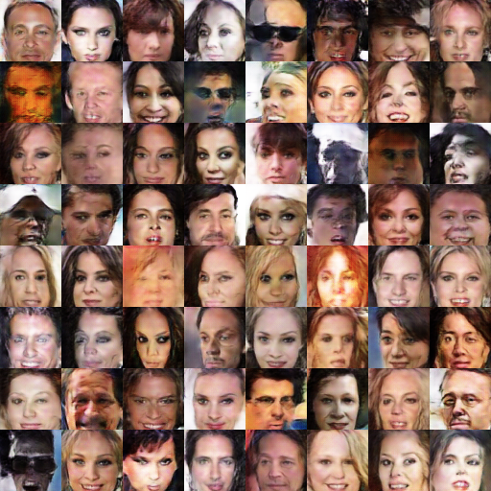
Adversarial Training

Slide 26
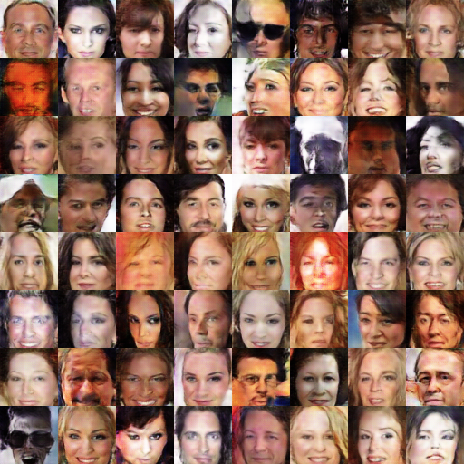
Adversarial Training

Slide 27
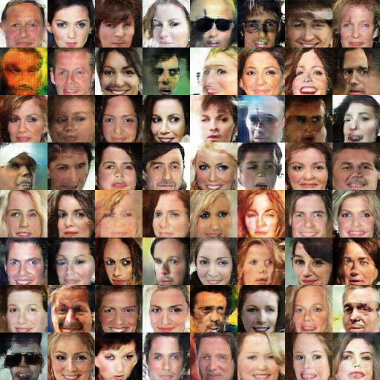
Adversarial Training

Slide 28
Adversarial Training
Train D to maximize the probability of the correct label.
Train D on both real images and samples from G
Train G to min log ( 1- D( G(z))
or max log D(G(z) )

Slide 29
Adversarial Training
Wasserstein GAN (Arjovsky et al.17]
Train D to maximize the probability of the correct label.
Train D on both real images and samples from G
Train G to min log ( 1- D( G(z))
or max log D(G(z) )

Slide 30
Lets go to the python notebook to run a Gan
Based on
https://github.com/carpedm20/DCGAN-tensorflow
https://github.com/AshishBora/csgm

Slide 31
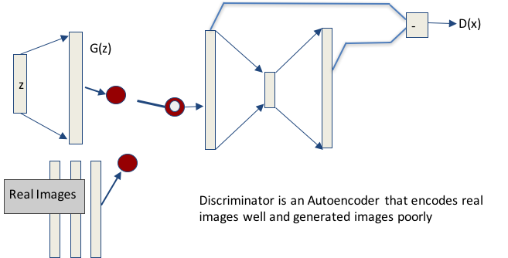
Current State of the Art: BeGANs

Slide 32
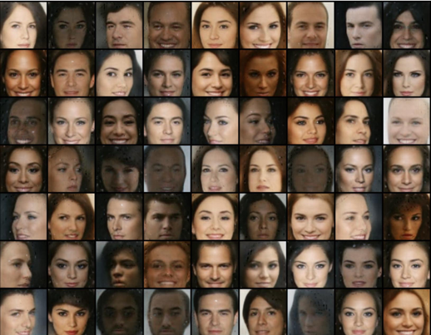
BeGANs produce amazing images

Slide 33
Ok, GANs produce amazing images.
Cool.
What can we actually do with them ?

Slide 34
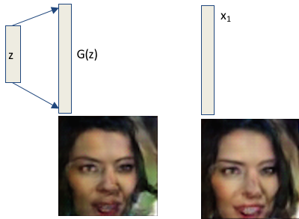
step 1: GAN inversion
Given a target image x1
How do we find a z such that
G(z) is close to x1?

Slide 35
step 1: GAN inversion
Given a target image x1
How do we find a z such that
G(z) is close to x1?
Write loss function
J(z) = || G(z) - x1||
Minimize with gradient descent on z!
Bora et al. (2017)
Creswell and Bharath (2016)
Donahue, Krahenbuhl,Trevor 2016
Dumoulin et al.
Adversarially learned Inference
Lipton and Tripathi 2017

Slide 36
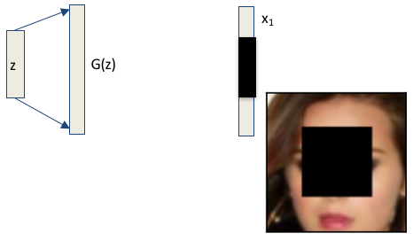
step 2: Inpainting

Slide 37
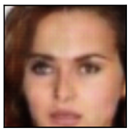
step 2: Inpainting

Slide 38
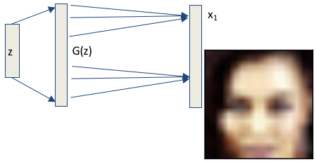
step 3: Super Resolution

Slide 39
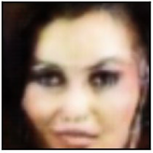
step 3: Super Resolution

Slide 40
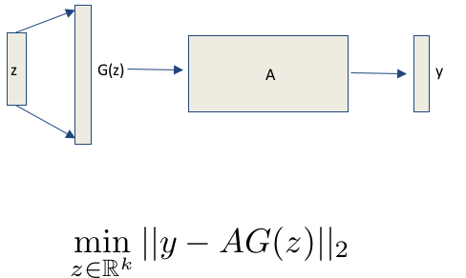
Step 4: Recovery from any linear measurements

Slide 41
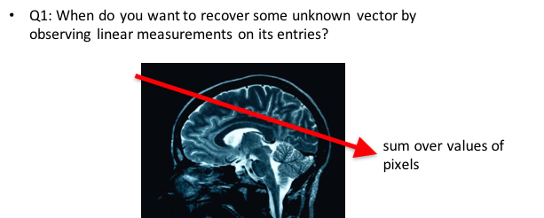
Step 4: Recovery from any linear measurements

Slide 42
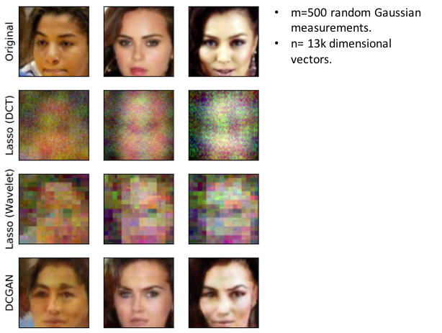
Compressed Sensing using GANs

Slide 43
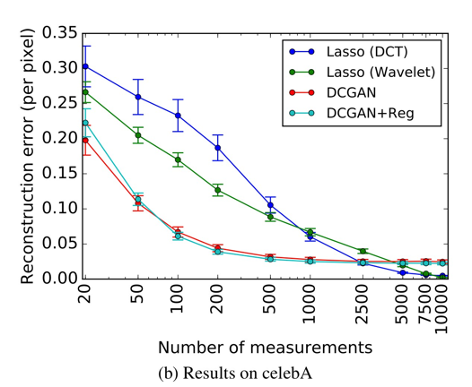
Compressed Sensing using GANs

Slide 44
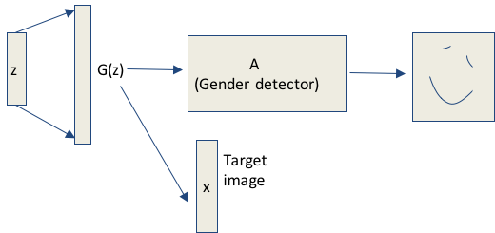
Nonlinear Measurements (unpublished work)

Slide 45
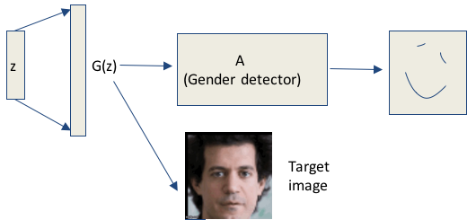
Nonlinear Measurements (unpublished work)

Slide 46
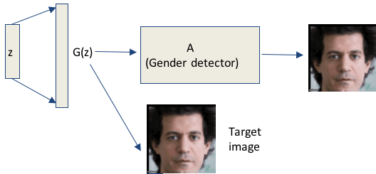
Nonlinear Measurements (unpublished work)

Slide 47

Nonlinear Measurements (unpublished work)

Slide 48
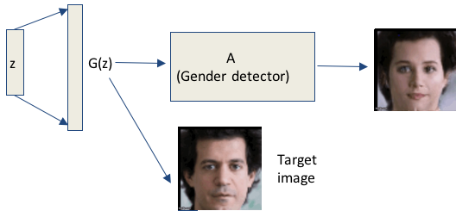
Nonlinear Measurements (unpublished work)

Slide 49

Nonlinear Measurements (unpublished work)

Slide 50
Directions in Current Research
1.We do not understand convergence and stabilization of training
2.We do not know when to stop.
3.We do not know how good are the samples from the distribution (incredibly strange ‘inception score’)
4.All sorts of hacks are improving performance (Clipping, Changing loss function, different schedules, step sizes)
5.We do not know how to sample from more general distributions
(e.g. natural images)
6.A generative model for house or customer data?
7.Interpretability and Causality
8.Major problem: Understanding generalization.

Slide 51
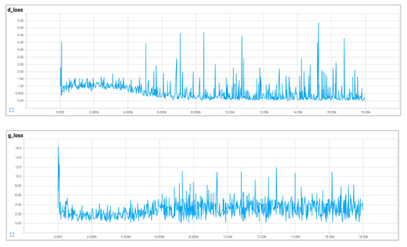
Training may not converge

Slide 52
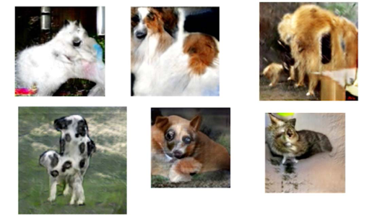
Sampling from ImageNet fails

Slide 53
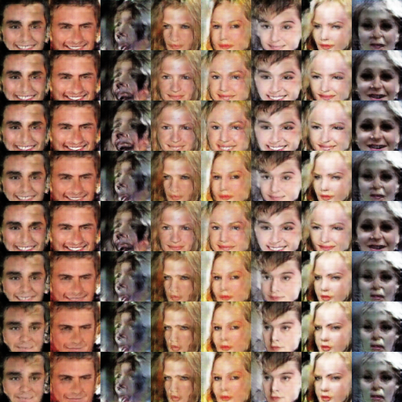

Slide 54
Gan Image To Image
x1
Inversion:
Find a z such that
min ||S(G(z)) - x1 ||
G(z)
z
Try https://affinelayer.com/pixsrv/index.html

Slide 55
Using Transfer Learning
and Interpretability
Alex Dimakis
Nikolaos Vasiloglou

Slide 56
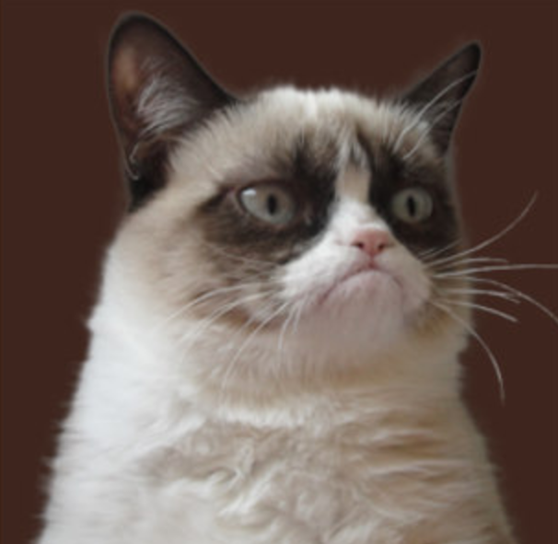
Get Inception V3 (massive pre-trained MLP)
Pr(cat) =0.7
Pr(banana) =0.01
Pr(grumpy) =0.2
...
Pr(dog) =0.02

Slide 57
Get Inception V3 (massive pre-trained MLP)
Trained on ImageNet.
Can recognize 1000 Class labels.
Trained on Millions of images,
Often better than typical human performance
Pr(cat) =0.7
Pr(banana) =0.01
Pr(grumpy) =0.2
...
Pr(dog) =0.02

Slide 58
Transfer Learning: How to leverage this power
https://research.googleblog.com/2016/03/train-your-own-image-classifier-with.html
Pr(cat) =0.7
Pr(banana) =0.01
Pr(grumpy) =0.2
...
Pr(dog) =0.02

Slide 59
Transfer Learning: How to leverage this power
https://research.googleblog.com/2016/03/train-your-own-image-classifier-with.html
Pr(cat) =0.7
Pr(banana) =0.01
Pr(grumpy) =0.2
...
Pr(dog) =0.02

Slide 60
Transfer Learning: How to leverage this power
https://research.googleblog.com/2016/03/train-your-own-image-classifier-with.html
Excellent image features.
Train a logistic regression on your problem.
Or an XGBoost classifier or any other model inside or outside TF.

Slide 61
Interpretability and Trust
``Why Should I Trust You?” Explaining the Predictions of Any Classifier.’’. Ribeiro et al. KDD 2016.
``Streaming Weak Submodularity: Interpreting Neural Networks on the fly.’’. (my group- uploaded on drive)
Problem: Given a black box model: ask
WHY did it give this label for this input.

Slide 62
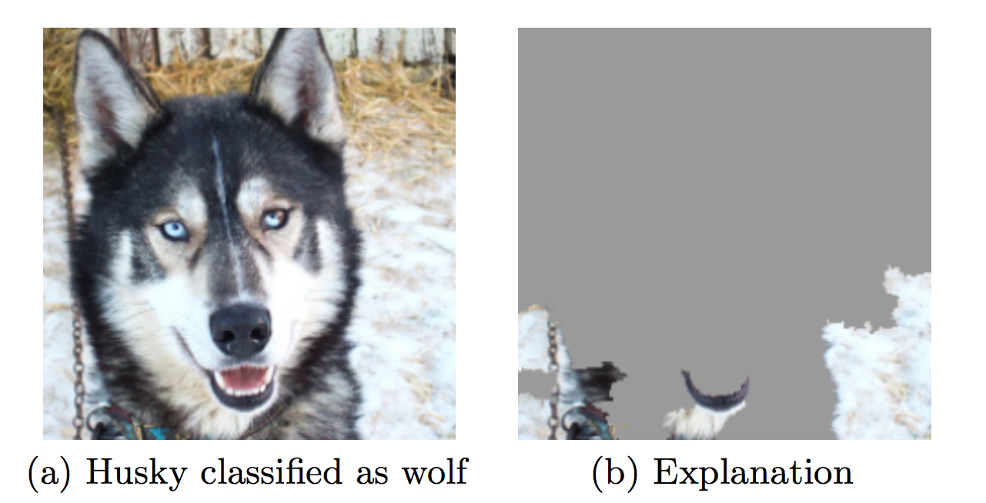
Interpretability and Trust
Interpretability is related to trust.

Slide 63
Interpretability and Trust
Interpretability is related to trust.
Malware detector had excellent accuracy over train-test split with true holdout.

Slide 64
Interpretability and Trust
Interpretability is related to trust.
Malware detector had excellent accuracy over train-test split with true holdout.
Was just checking if the code had comments.

Slide 65
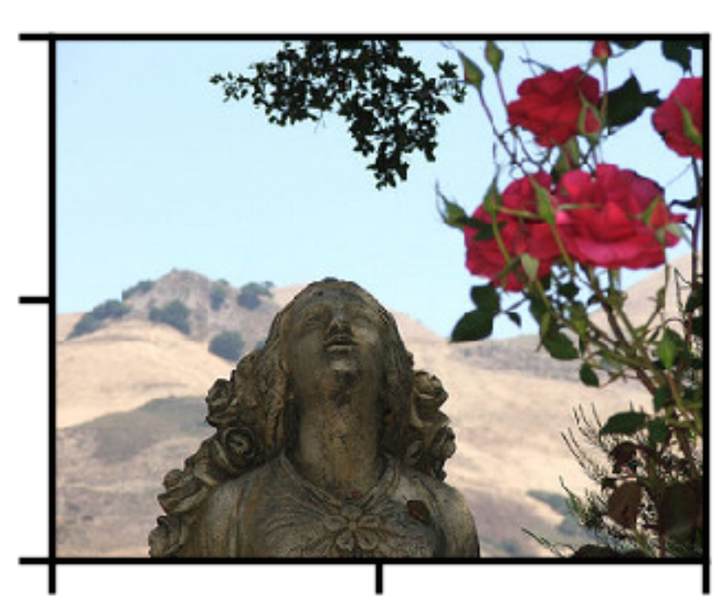
The idea:
R1
Segment image into regions
Feed subsets of the regions in the black box.
Black out the rest image.
Find which 3 regions maximize the likelihood of ‘Rose’
R2

Slide 66
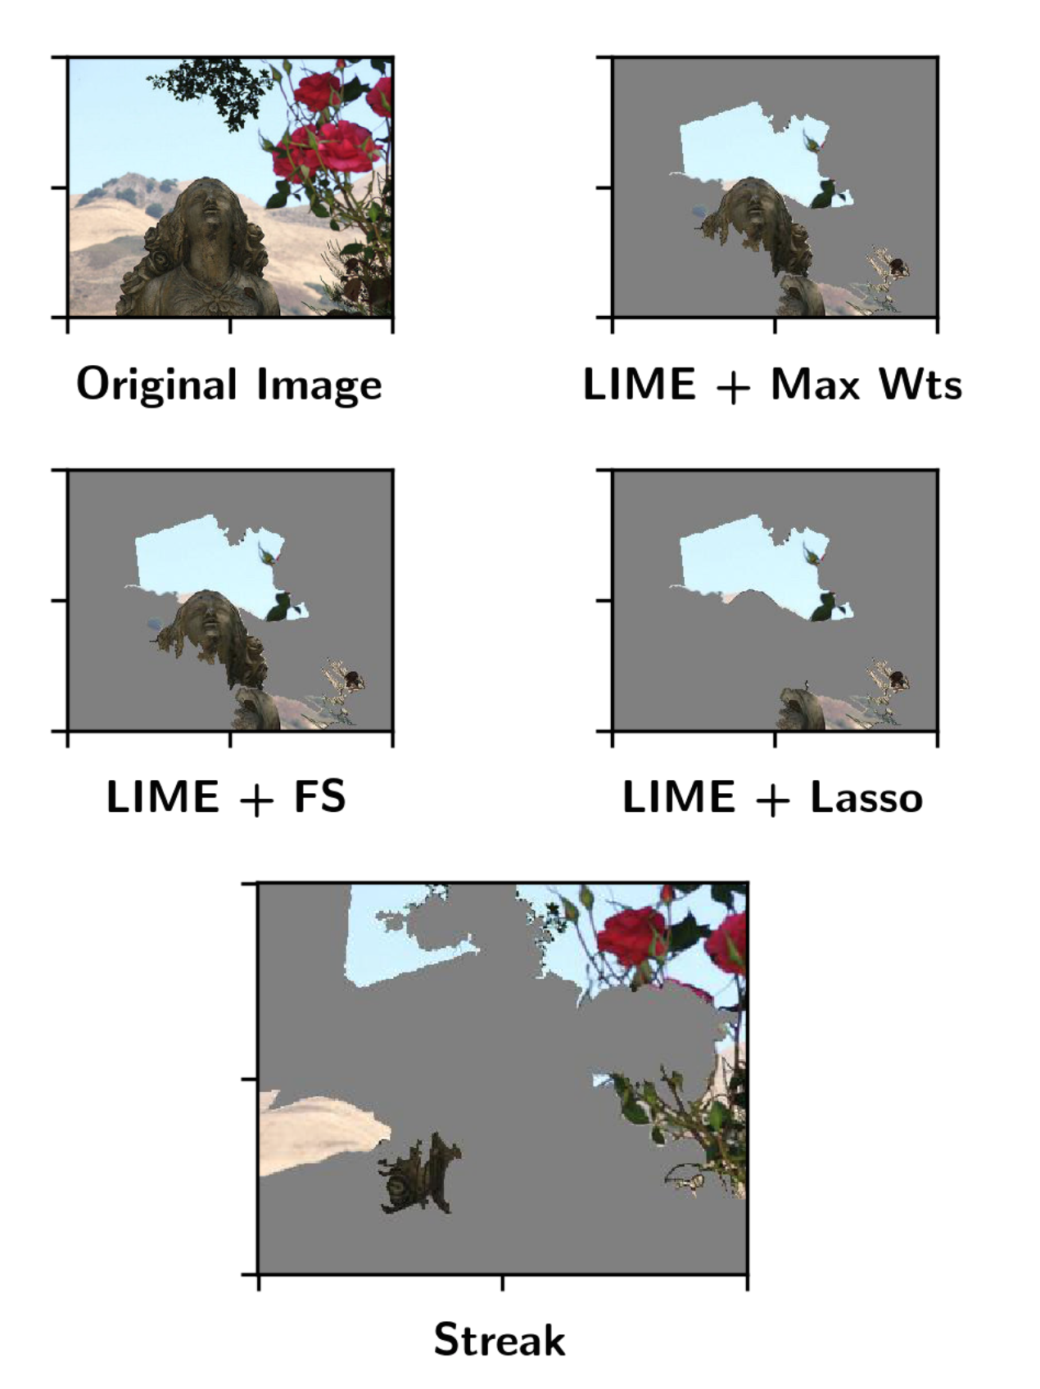
Lime and Streak

Slide 67
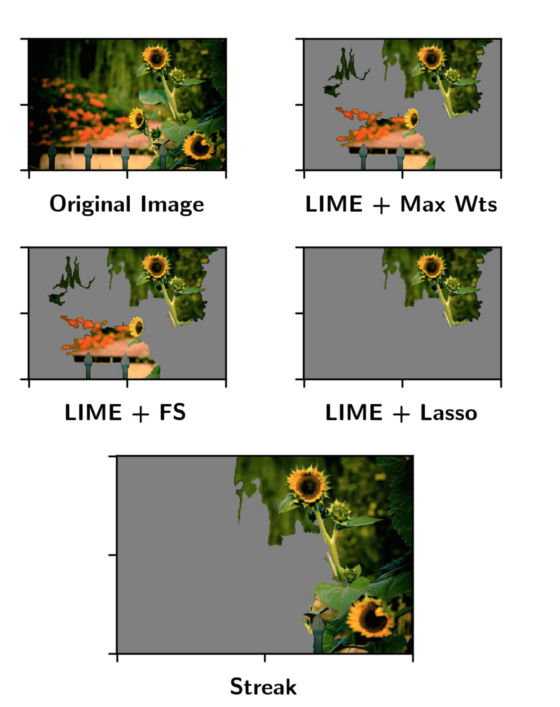
Lime and Streak

Slide 68
Interpretability and Trust
This is a very complex and hot topic in ML currently
Trusting for deployment
For scientific discovery

Slide 69
Interpretability and Trust
This is a very complex and hot topic in ML currently
Trusting for deployment
For scientific discovery
For Discrimination and Fairness

Slide 70
Interpretability and Trust
This is a very complex and hot topic in ML currently
Trusting for deployment
For scientific discovery
For Discrimination and Fairness
(e.g. Loan applications, Employment, News, ?)

Slide 71
Interpretability and Trust
This is a very complex and hot topic in ML currently
Trusting for deployment
For scientific discovery
For Discrimination and Fairness
(e.g. Loan applications, Employment, News, ?) Very interesting complex topic:
http://www.mlandthelaw.org/slides/hajian.pdf
http://www.mlandthelaw.org/ http://www.fatml.org/resources

